Slide 1
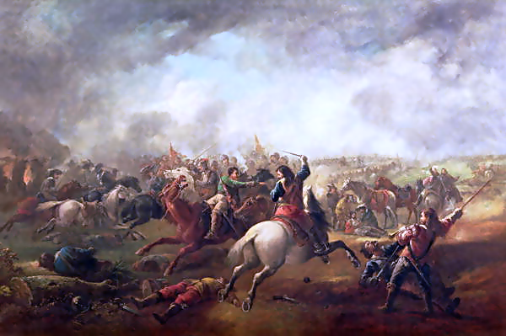
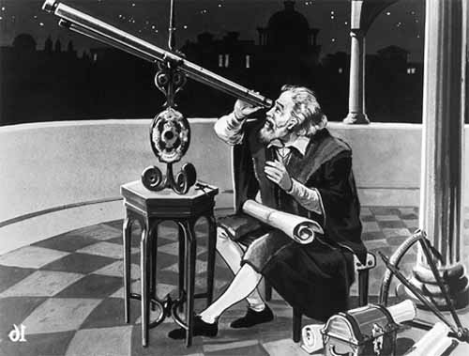
Hobbes I: Civil War and the New Science
Politics 2A
Dr Carl Knight, Lecturer in Political Theory

Slide 2
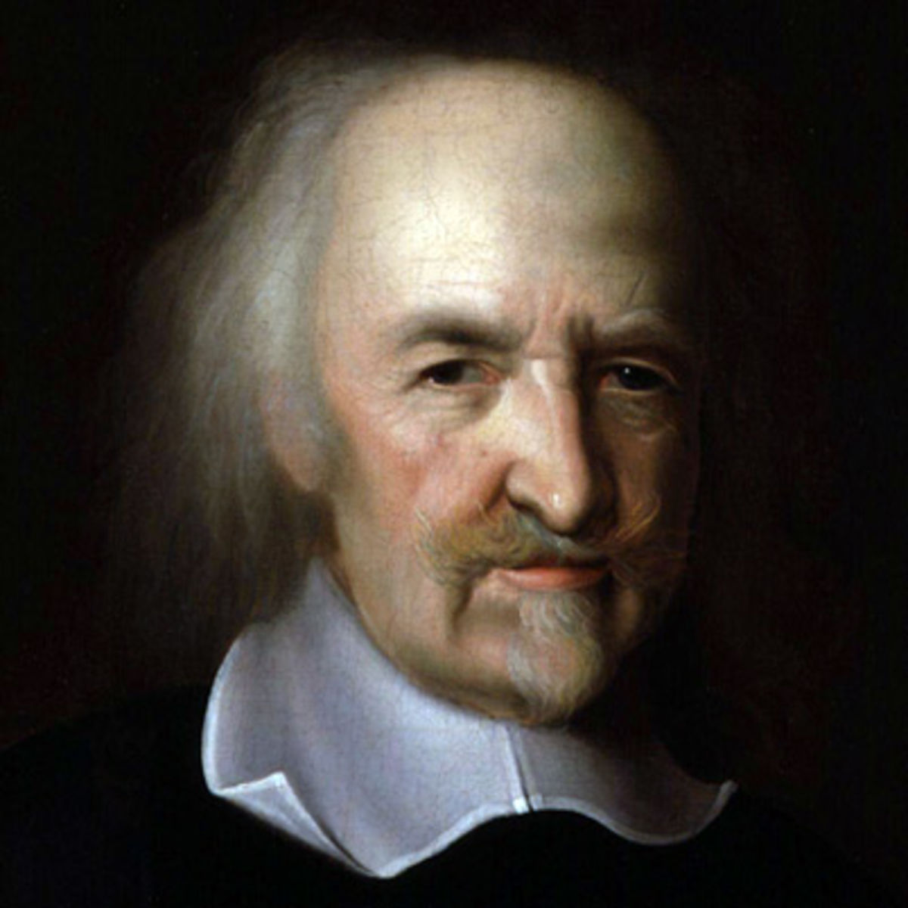
LECTURE OVERVIEW
Historical background
The life and works of Thomas Hobbes
Hobbes’ account of science, reason, the passions and morality

Slide 3
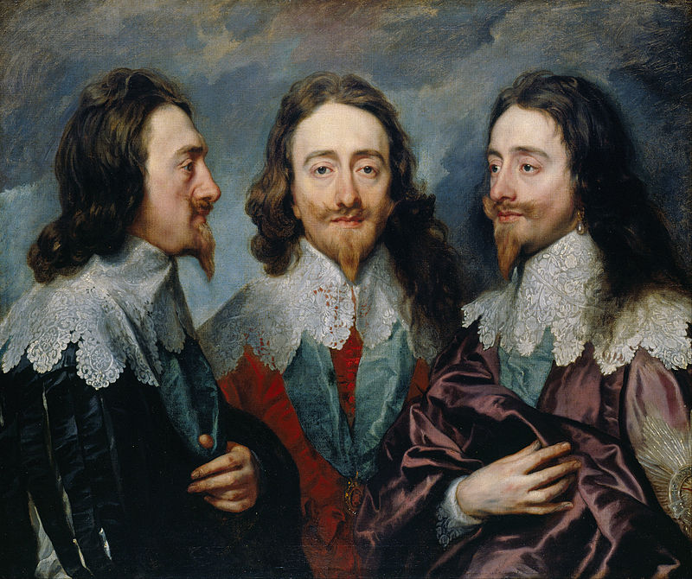
CHARLES I (1600-1649)
King of England, Ireland, and Scotland (1625-1649)
Succeeded James VI of Scotland (James I of Eng/Ire)
Like father, believed in divine right of kings, but less willing to compromise – answerable only to God

Slide 4
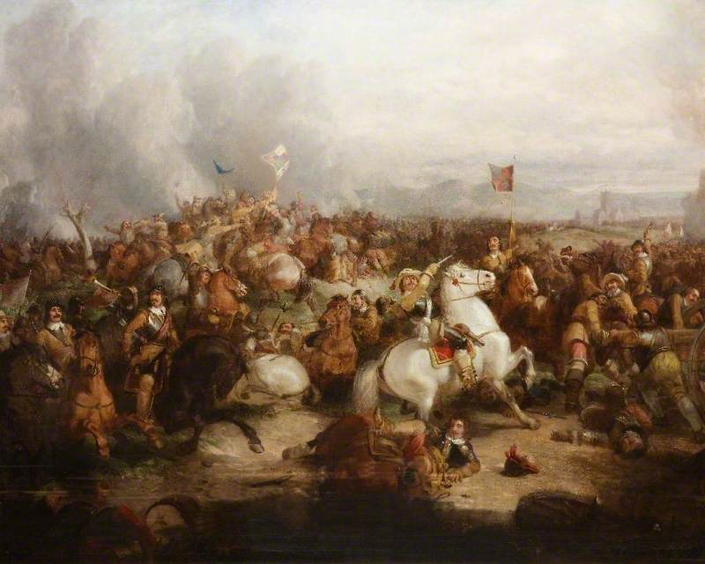
WARS OF THE THREE KINGDOMS
Started in Scotland in 1639, encompassing the Eleven Years War in Ireland & 3 civil wars in England
Charles I was beheaded in 1649 and his son Charles II exiled after defeat by Cromwell in 1651

Slide 5
CAUSES OF THE CIVIL WARS
Central issue was ‘personal rule’ of Charles I, which created conflict with parliaments, e.g. levying taxes
Religion important as well - Charles’ imposition of high Anglicanism resisted by presbyterians, and Catholic vs. Protestant conflict in Ireland
Also a national dimension - Scottish resistance to England, and Irish Confederate conflict with English and Scottish forces

Slide 6
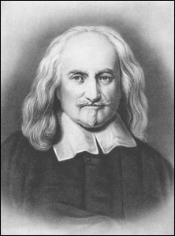
THOMAS HOBBES (1588-1679)
Born Malmsbury, educated Magdalen Hall, Oxford
Served as tutor and secretary to Cavendish family (Devonshire)
Travelled Europe in 1629-1631 & 1634-1637
In exile during Civil War period (1640-51), had Royal protection after the restoration (1660)

Slide 7
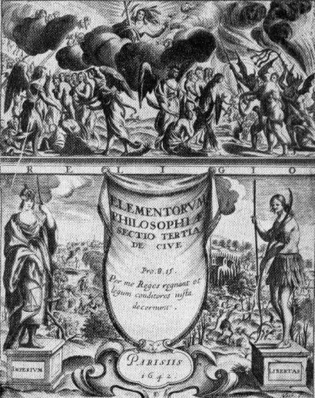
WORKS
Classical translations
Elements of Law (including De Cive) (1642)
Behemoth (1679)
Most famous work is Leviathan (1651)

Slide 8
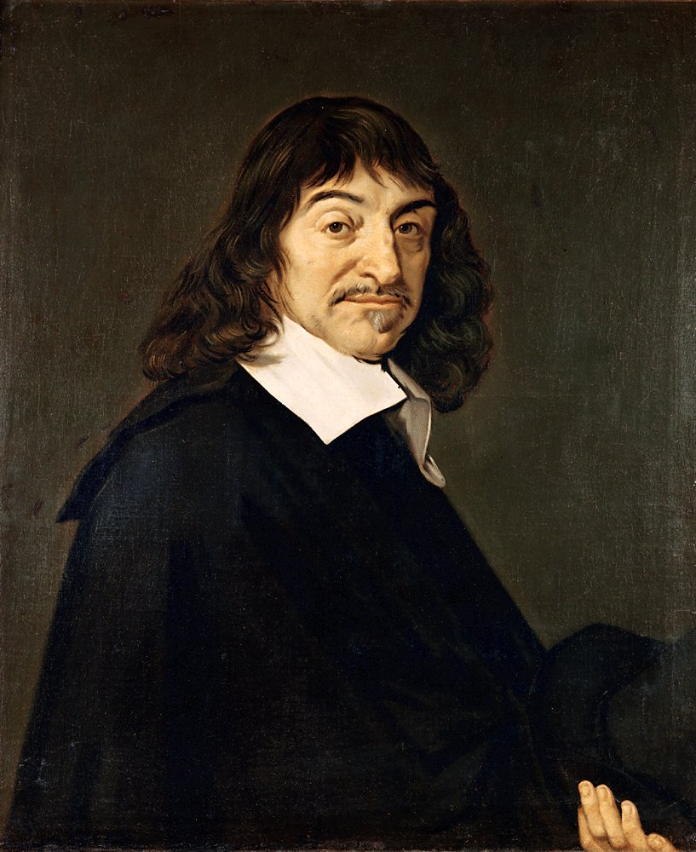
SCEPTICISM
Spent time with intellectuals such as Descartes in Paris
Influenced by renaissance scepticism about knowledge
Rejects Aristotle’s moral objectivism (moral facts)
Accepted moral scepticism, or more precisely moral relativism (egoism?)

Slide 9
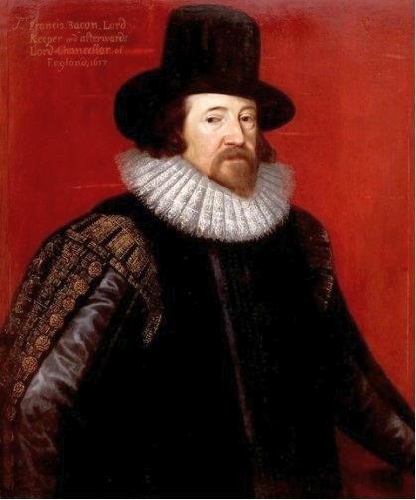
SCIENCE
Also influenced by scientific revolution (Bacon, Galileo)
Rejected physical scepticism - we can detect ‘motions’
Adopted the ‘resolutive- compositive’ method
E.g. human psychology can be broken down into a system of matter in motion

Slide 10
REASON
An empiricist but not a thoroughgoing one – science is a matter of drawing the logical consequences of definitions though these do draw on observations
All thinking is addition and subtraction (‘reckoning’):
‘Out of all which we may define, that is to say determine, what that is, which is meant by this word reason, when we reckon it amongst the faculties of the mind. For reason, in this sense, is nothing but reckoning, that is adding and subtracting, of the consequences of general names agreed upon for the marking and signifying of our thoughts; I say marking them when we reckon by ourselves, and signifying, when we demonstrate or approve our reckonings to other men’ (Leviathan, ch. 5)

Slide 11
PASSIONS
These are the ‘Interiour Beginnings of Voluntary Motions’, which motivate us to act
Intermediate between ‘Vitall’ and ‘Voluntary’ motions
This passion or ‘endeavour’ pulls in either direction:
‘This endeavour, when it is toward something which causes it, is called appetite, or desire; the latter, being the general name; and the other oftentimes restrained to signify the desire of food, namely hunger and thirst. And when the endeavour is fromward something, it is generally called aversion’ (Leviathan, ch. 6)
Deliberation=reason weighing conflicting passions

Slide 12

THE GOOD
This theory of passions shapes Hobbes’ account of the good:
‘Whatsoever is the object of any mans appetite or desire; that is it, which he for his part calleth good: and the object of his hate, and aversion, evill; And of his contempt, vile and inconsiderable. For these words of good, evill, and contemptible, are ever used with relation to the person that useth them: there being nothing simply and absolutely so; nor any common rule of good and evill, to be taken from the nature of the objects themselves’ (Leviathan, chapter 6)

Slide 13

ACTIVITY
Do you agree with Hobbes that ‘these words of good, evill, and contemptible, are ever used with relation to the person that useth them: there being nothing simply and absolutely so’?
You may wish to discuss Hobbes’ arguments about:
science and reason
passions
the good

Slide 14
POWER
‘The power of a man, … is his present means, to obtain some future apparent good’ (Leviathan, ch. 10)
‘The value, or worth of a man, is as of all other things, his price; that is to say, so much as would be given for the use of his power’
‘I put for a generall inclination of all mankind, a perpetuall and restlesse desire of power after power, that ceaseth only in death’ (Leviathan, ch. 11)
May be merely to secure existing standard of living

Slide 15
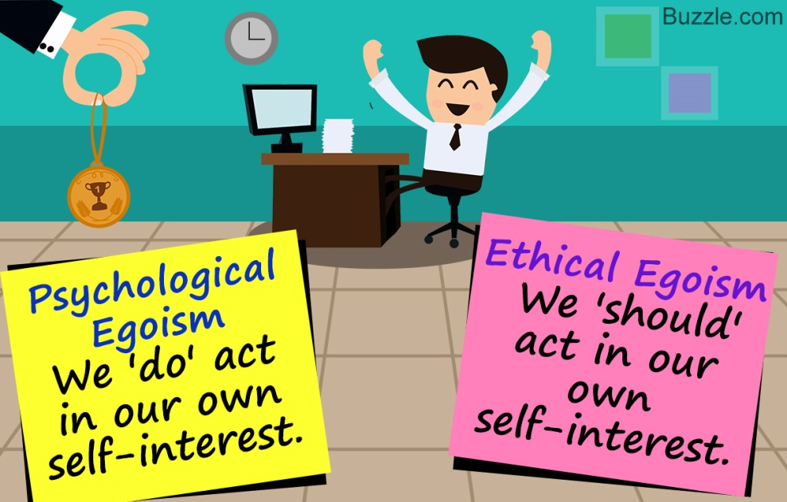
IS HOBBES AN EGOIST?
4 interpretations (Baumgold):
Yes, our self-interested nature is basis of morality
Kind of - what an individual wants is in her interest (more egoistic psychology than egoistic morality?)
No, we’re moral agents that obey a natural law, e.g. promise-keeping
Solipsism – ‘His doctrine is that each man is unavoidably shut up within the world of his own sensations’ (Oakeshott). Knowledge is first-personal

Slide 16
POSITION OF IDEAS IN HISTORICAL CONTEXT
The intellectual conflict of the Civil War was between royalist divine right to rule, and radical rejection of royal authority
Hobbes occupied unusual position – monarchist that rejected religious justification
Attempt to expand appeal of monarchy by providing it with a ‘scientific’ justification
In the next two lectures we’ll see how that justification unfolds

Slide 17

Next Lecture: The State of Nature

